Slide 1
IEEE 802.11 WLAN STANDARDS
Name- Shivani
Roll no.- 54

Slide 2
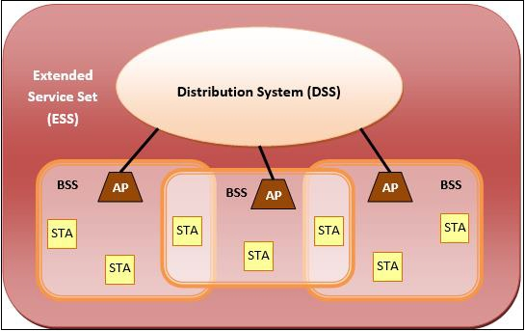
IEEE 802.11 Architecture

Slide 3
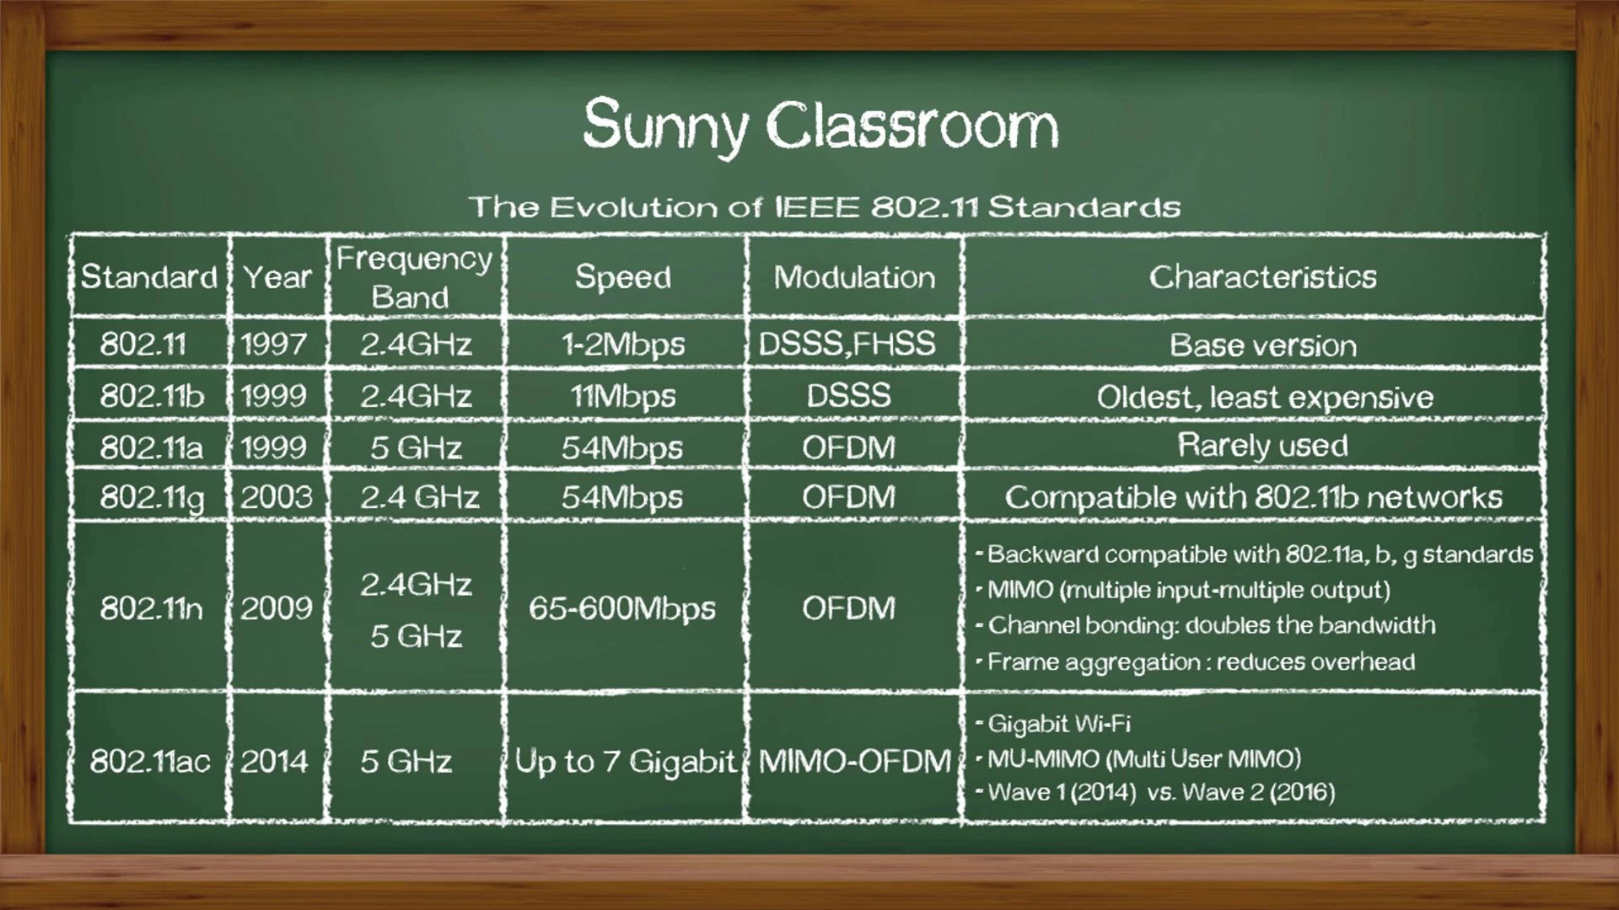
IEEE 802.11 WLAN Standards

Slide 4
THANKYOU

